Slide 1

Nuclear Imaging I (SPECT)
RT4220 – Lecture #12
Kedree Proffitt
WSU
10/27/2025

Slide 2
Basics of Nuclear Medicine
Patient presents with a disease → suspected disease can be imaged with a particular radioactive tracer → radioactive tracer is injected → an image is formed of the disease by a machine
The underlined section is the only difference between gamma cameras, single photon emission computed tomography (SPECT), positron emission tomography (PET), and now Compton cameras
All nuclear medicine detectors are either scintillator or semiconductor based
Nuclear imaging permits functional imaging, exceptionally important!

Slide 3
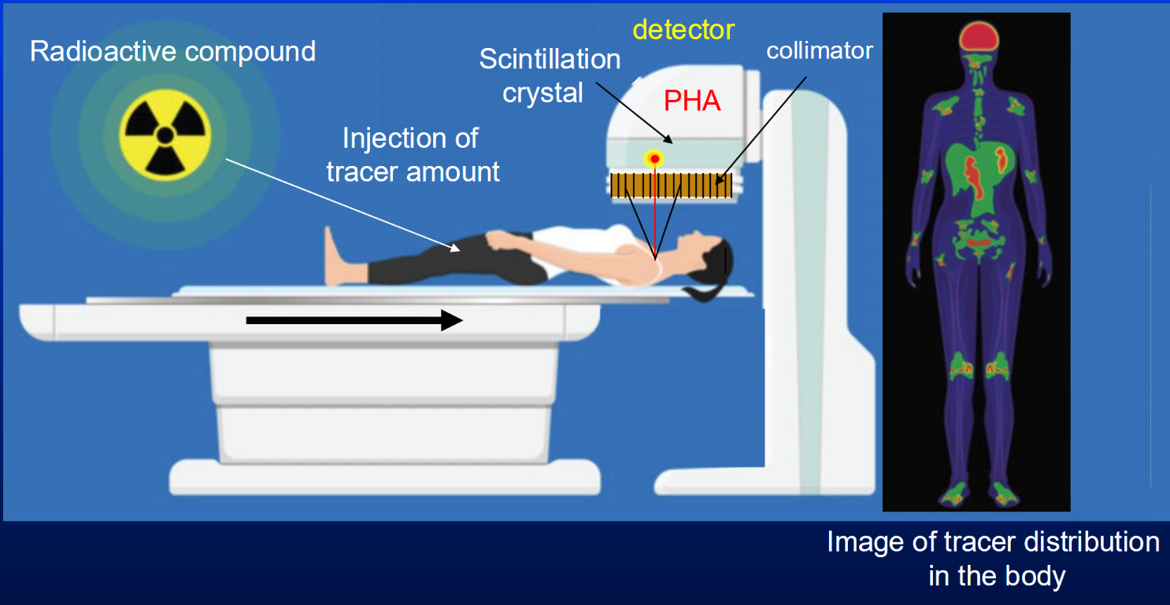

Slide 4
Modes of Nuclear Imaging I
Gamma Camera
Planar images via projections
Typically scintillators and PMTs
Physical collimation
Uses low-energy photon emitters
SPECT
Tomographic imaging (3D) via step-and-shoot planar images
Typically scintillators and PMTs
Physical collimation
Uses low-energy photon emitters

Slide 5
Modes of Nuclear Imaging II
PET
Intrinsically tomographic data (3D)
Typically scintillators, but moving towards semiconductors
Electronic collimation
Uses positron emitters (high-energy photons)
Generally better spatial resolution and sensitivity than SPECT
Functional imaging

Slide 6
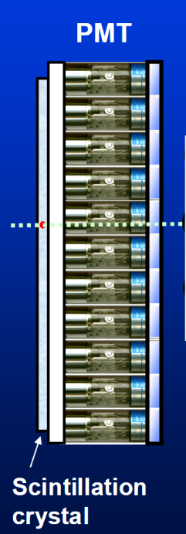
Gamma Camera Basics
Injection
Gamma photons generated by beta- emitter or Tc-99m
Photons leave patient and pass through collimator
Remaining photons are scintillated (each keV produces roughly 38 low energy photons in the visible band for NaI(Tl))
PMT converts scintillated photons into electronic signal
A pulse height analyzer rejects suspected non-valid events
A position logic circuit determines the origin location of each signal, now it is counted!
Many counts are summed together to form a planar image

Slide 7
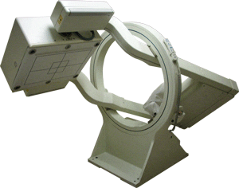
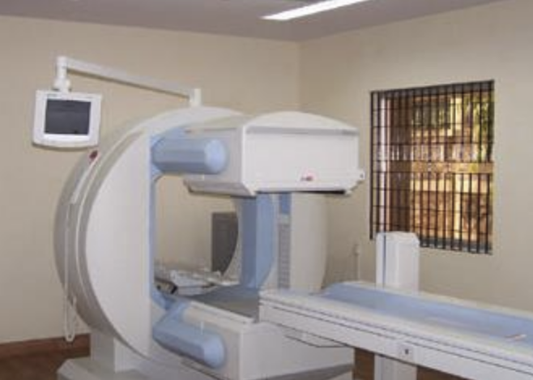

Slide 8
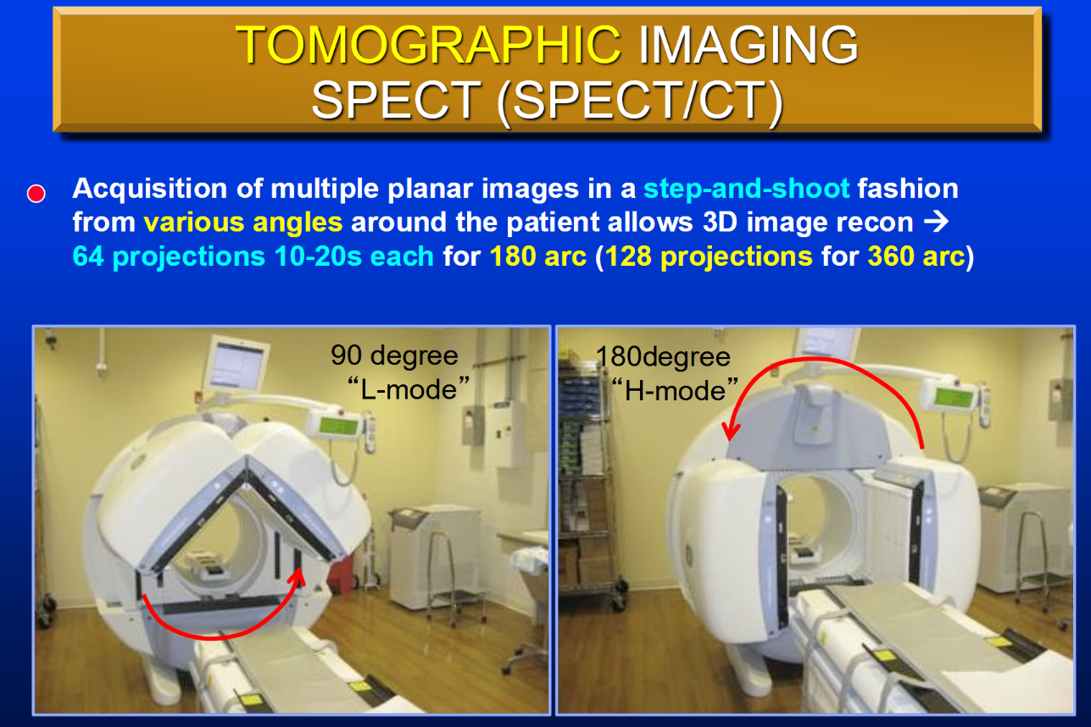

Slide 9
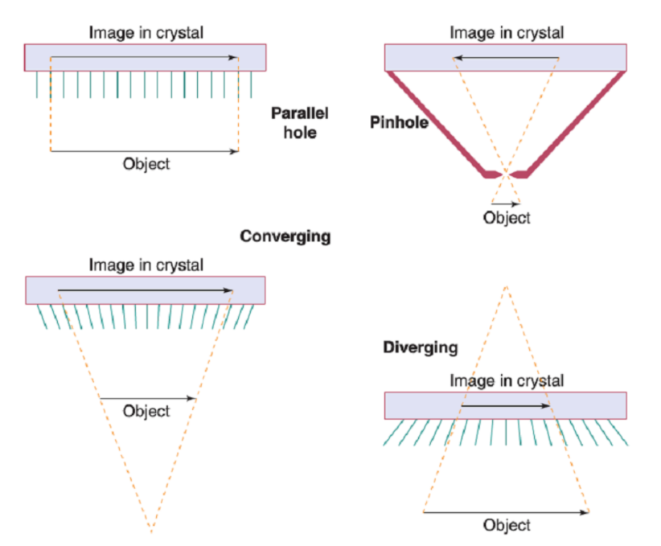
Step Three: Collimation
Parallel hole is most common in nuc. med.
Pinhole is used for thyroid uptake analysis
There are other forms of collimation that are gaining prominence, but are too complicated for us

Slide 10
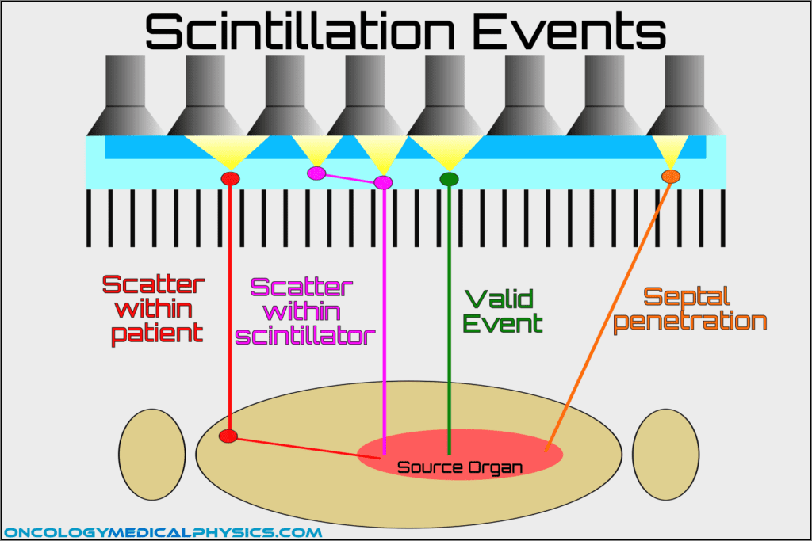
Step Four: Possible Photon Fates

Slide 11
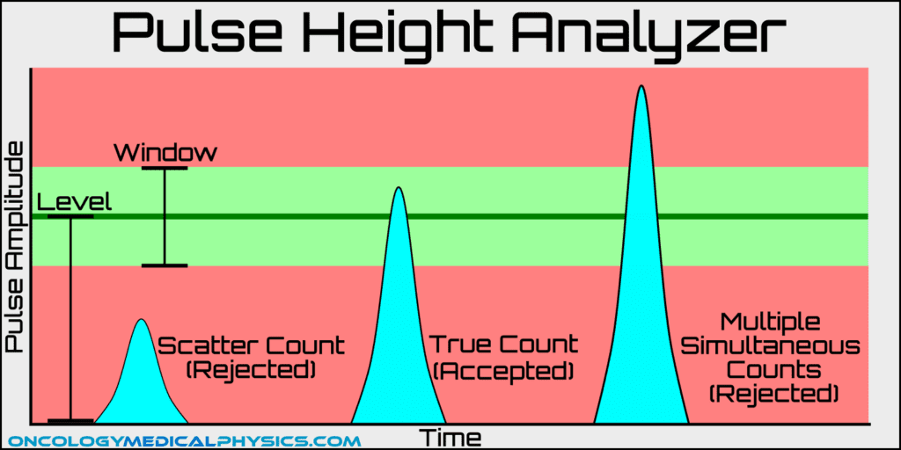
Step Six: Discrimination of Energy

Slide 12
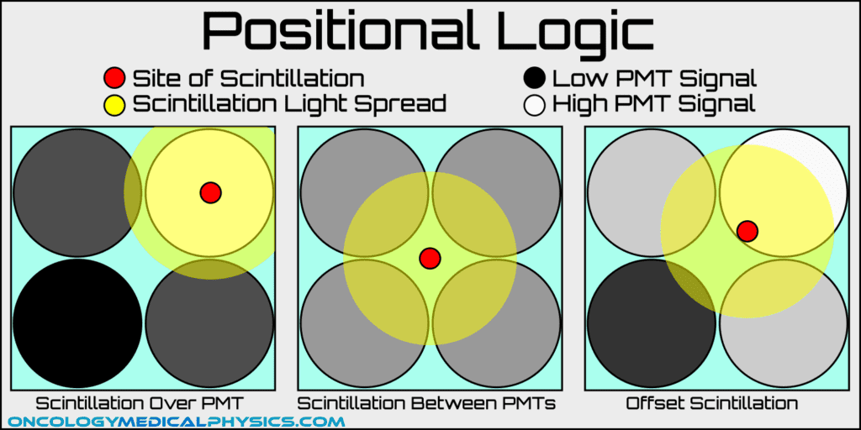
Step Seven: Event Localization

Slide 13
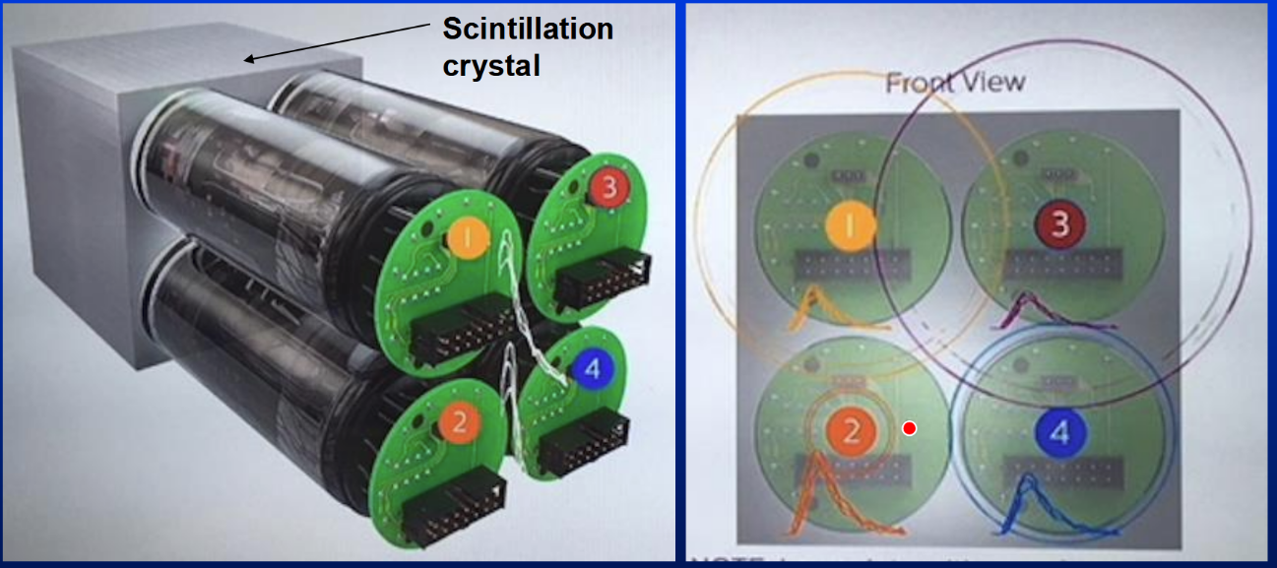
Step Seven Continued

Slide 14
Common Procedures
Ask the nuc. med. people what they see most (Almost all are Tc-99m based)
Bone Scans
Cancer
Occult Fractures
Osteomyelitis/Arthritis
Cardiac Scans
Metastatic Cancer
Prostate Cancer
Neurological Scans

Slide 15
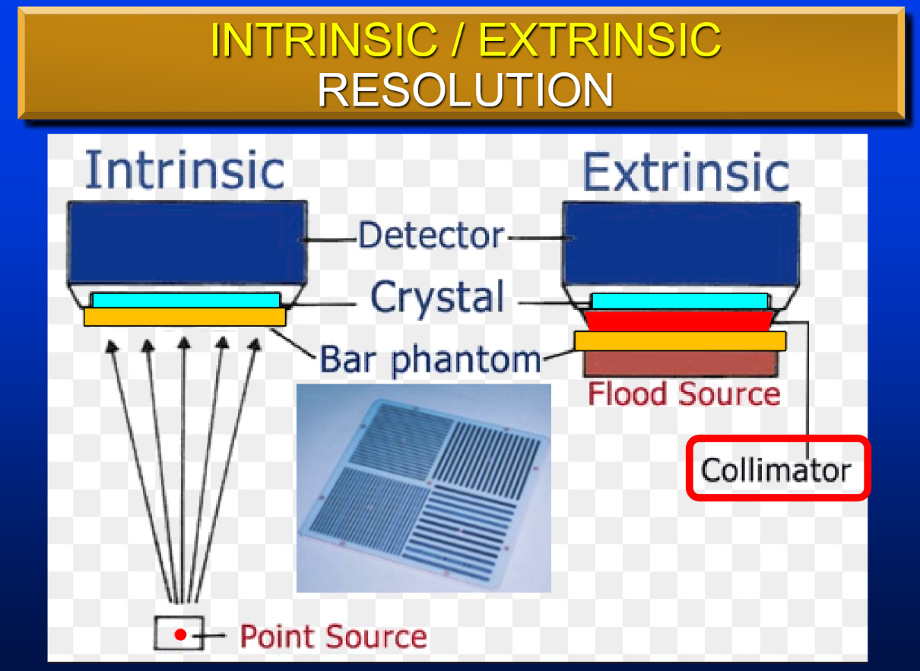

Slide 16
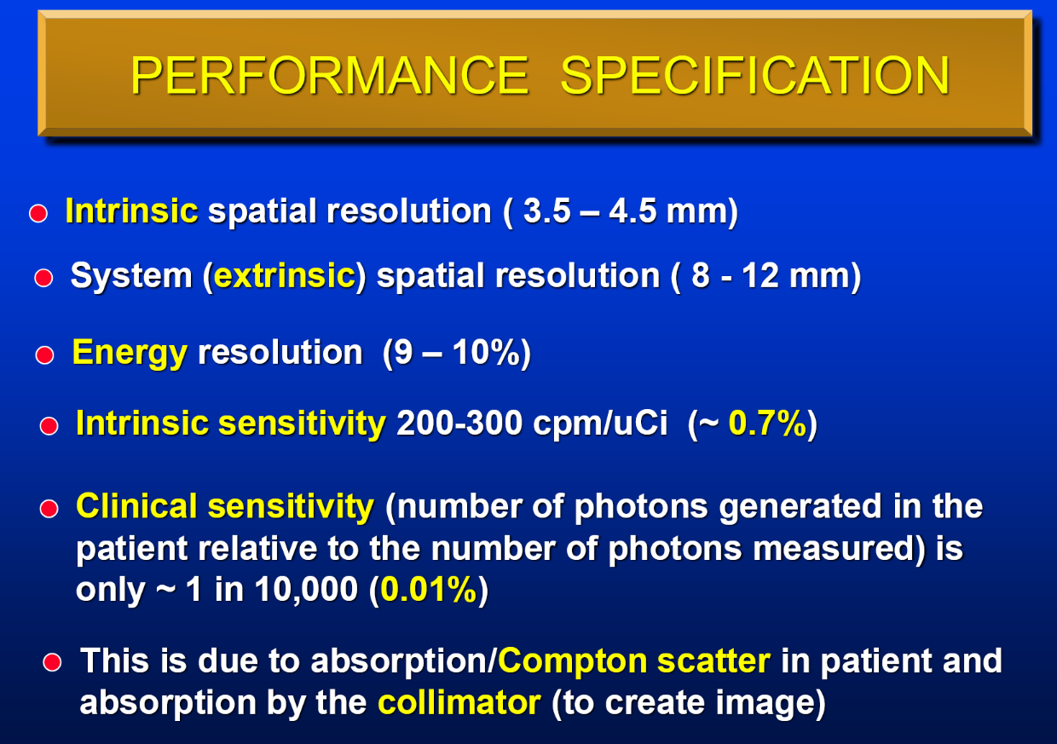

Slide 17
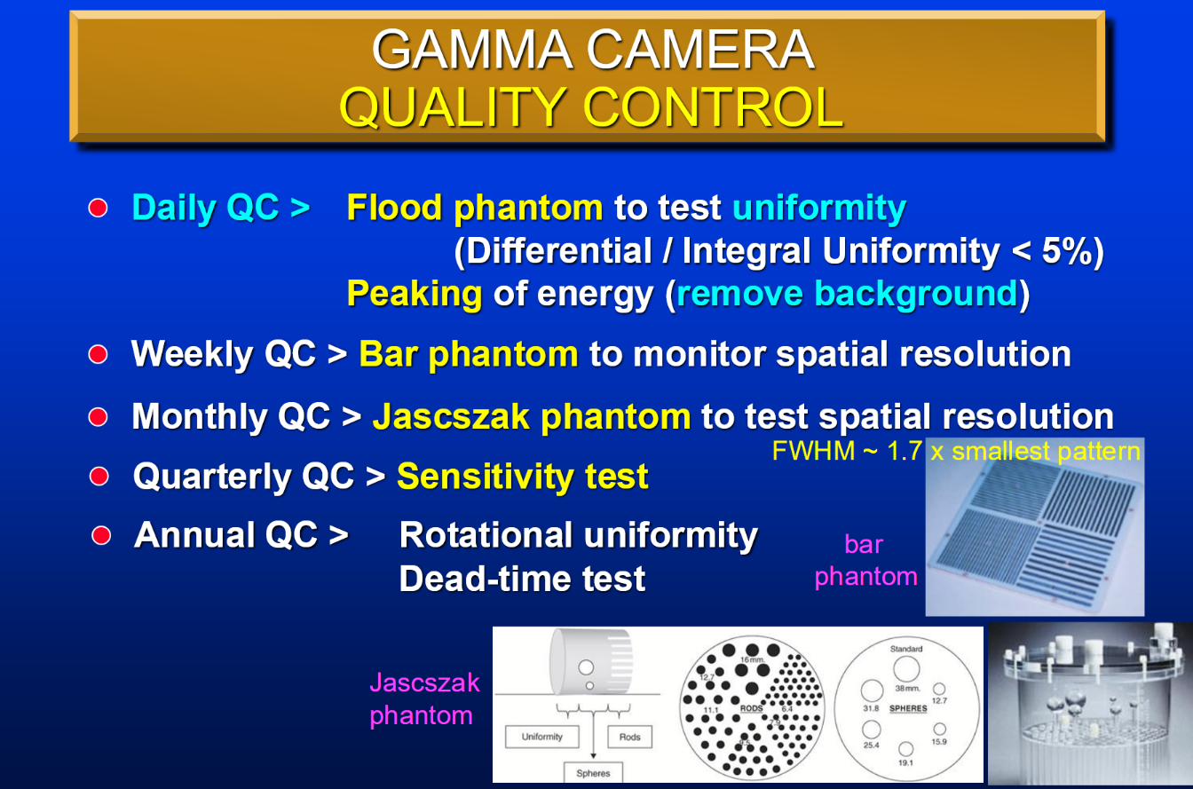

Slide 18
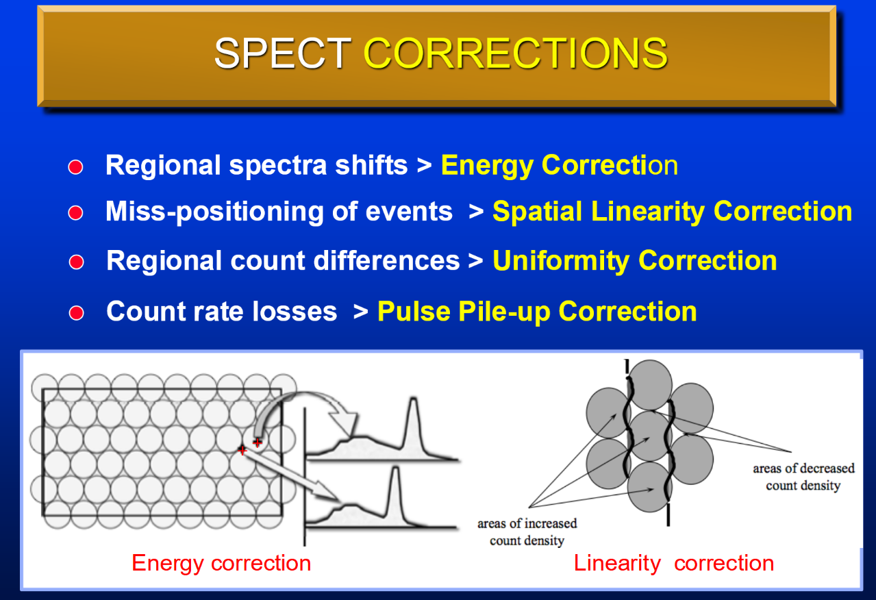

Slide 19
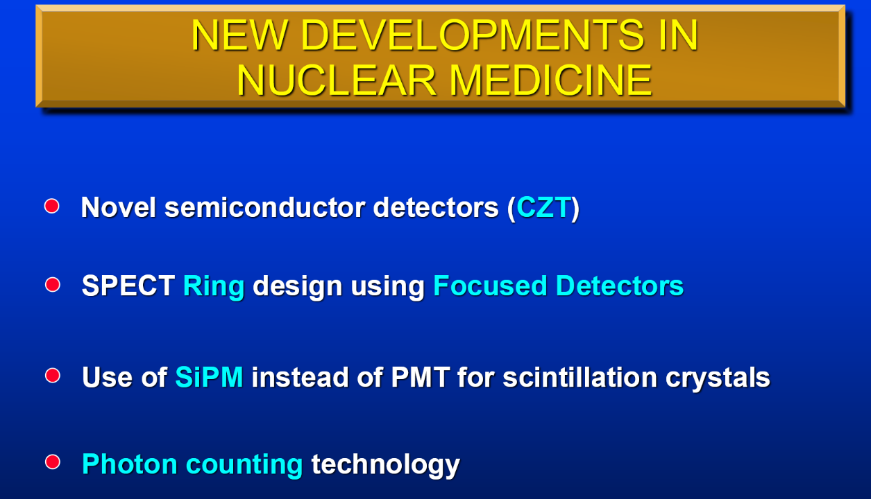

Slide 20
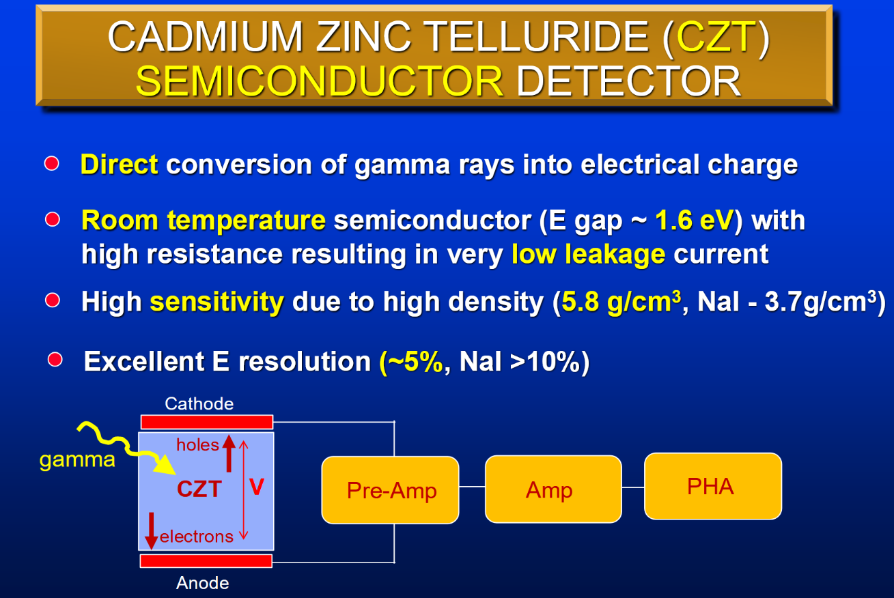

Slide 21
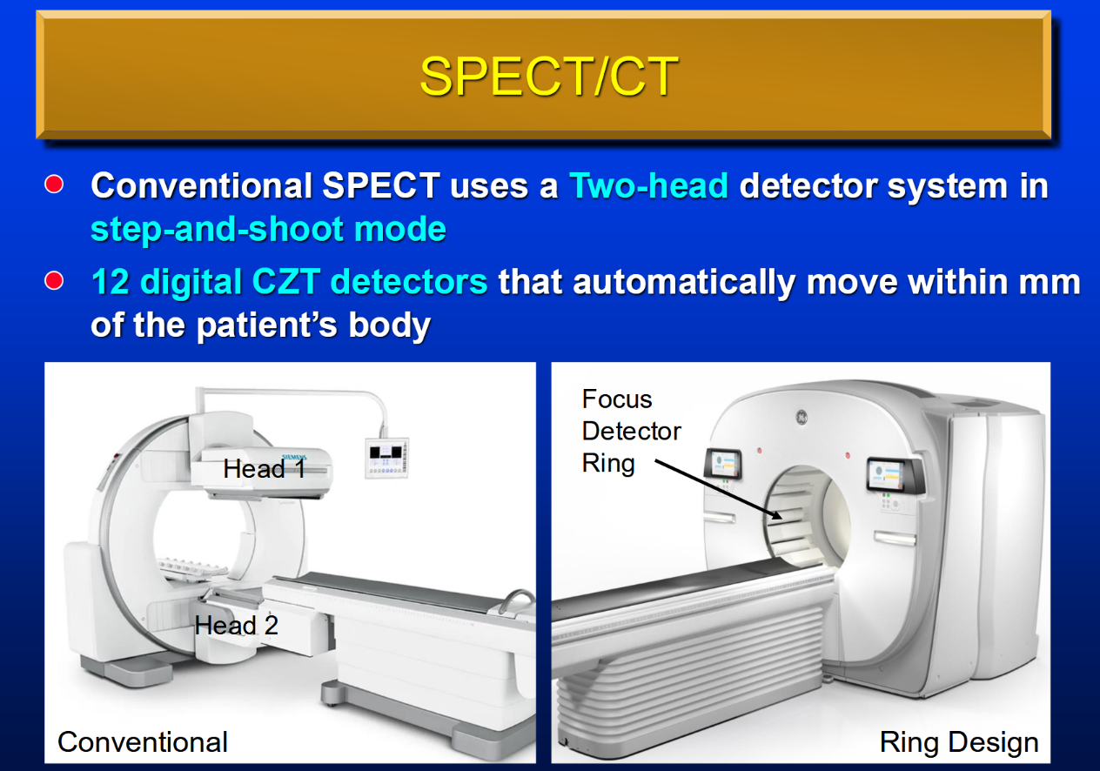

Slide 22
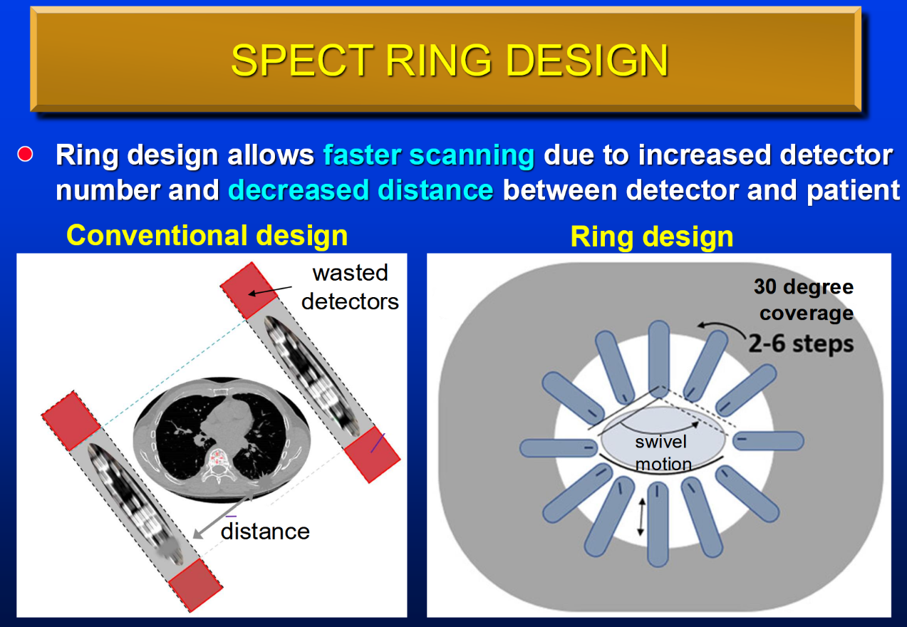

Slide 23
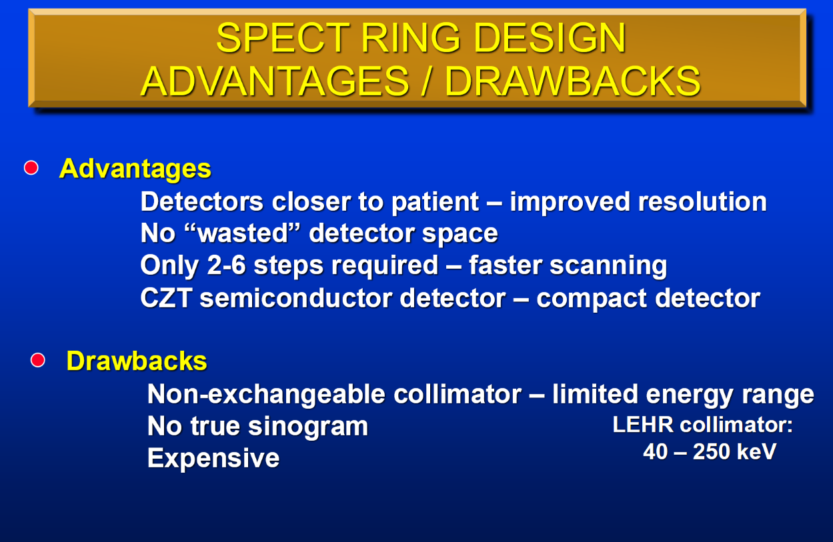
Notes:
Some new notes: Physicians HATE NOT HAVING A TRUE PLANAR IMAGE

Slide 24
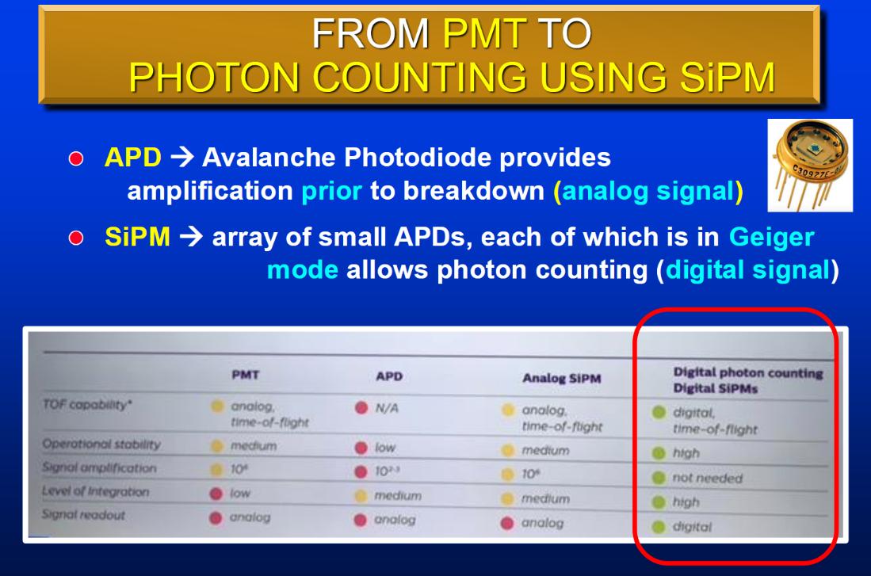

Slide 25
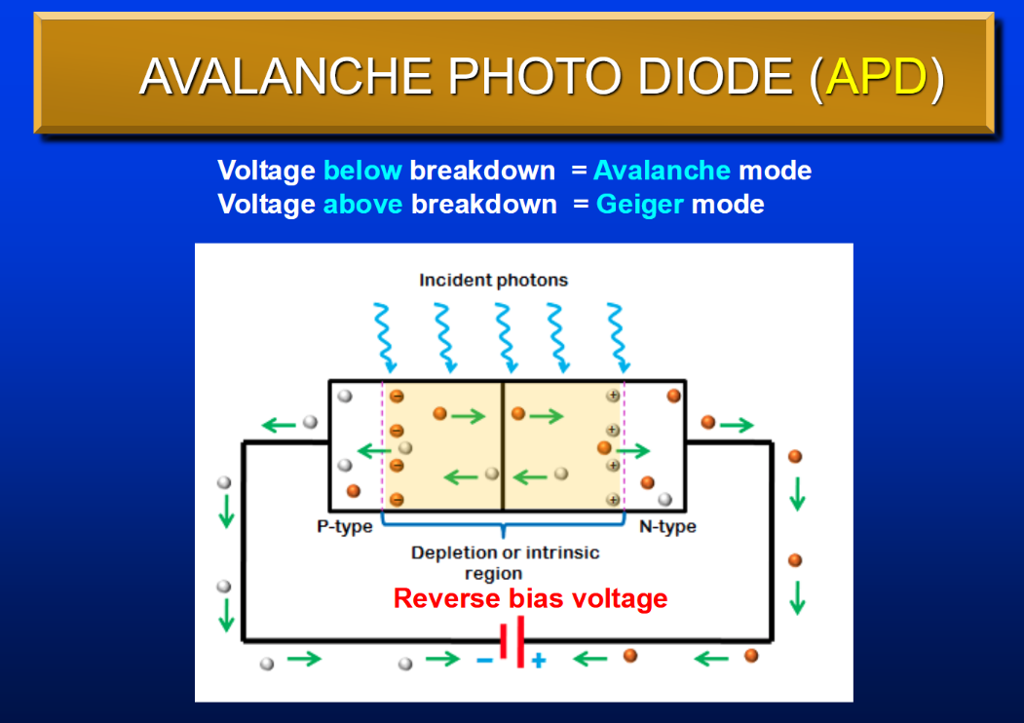

Slide 26
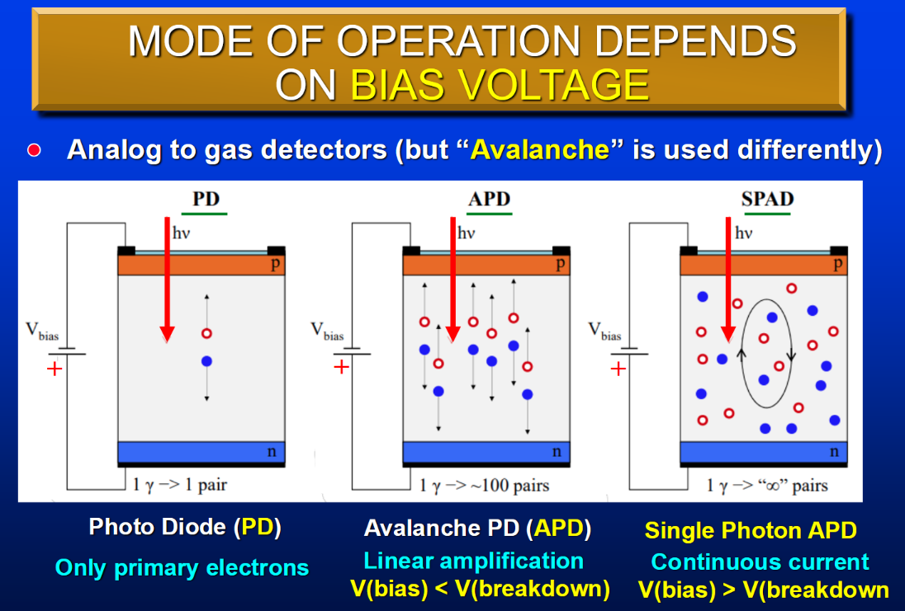

Slide 27
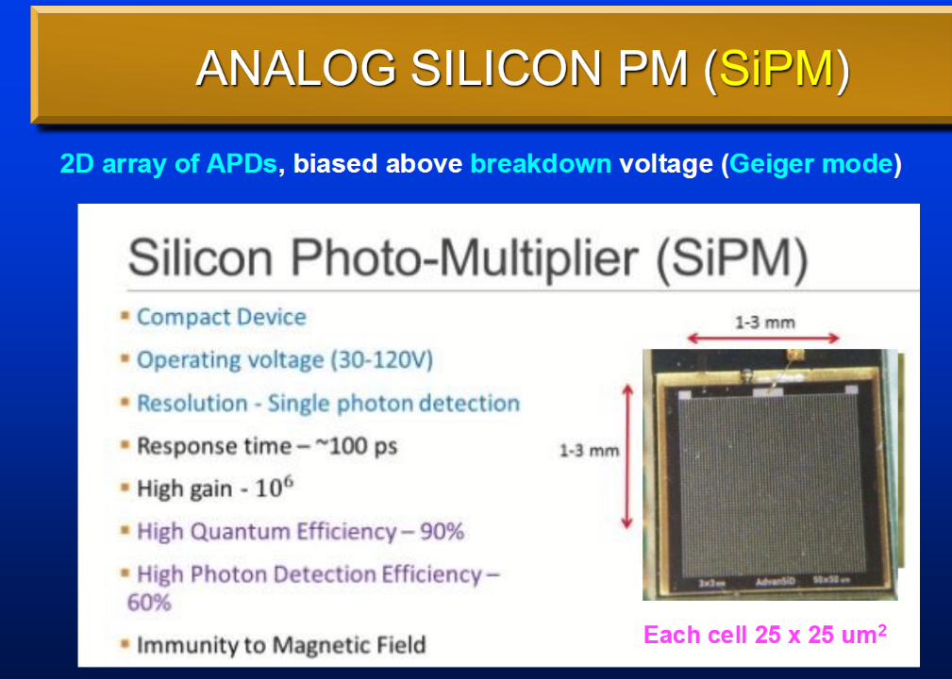

Slide 28
